Slide 1
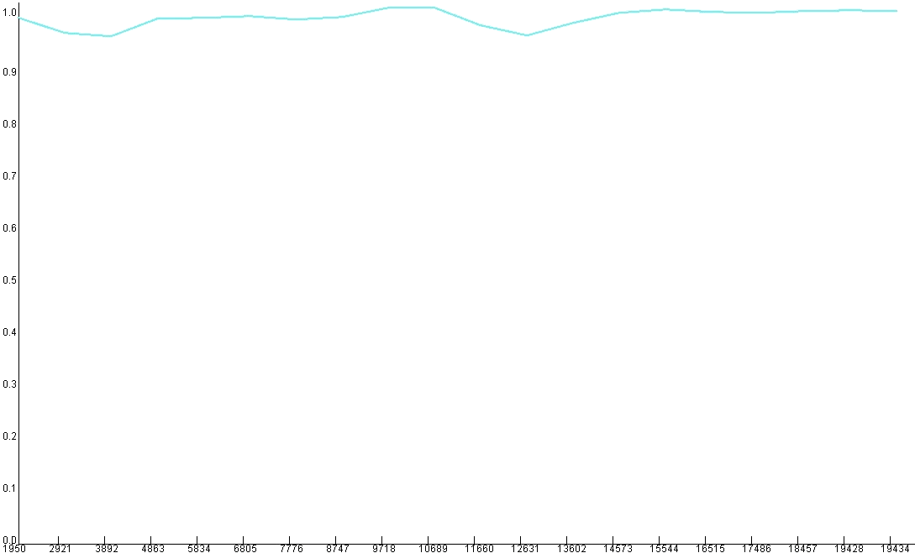
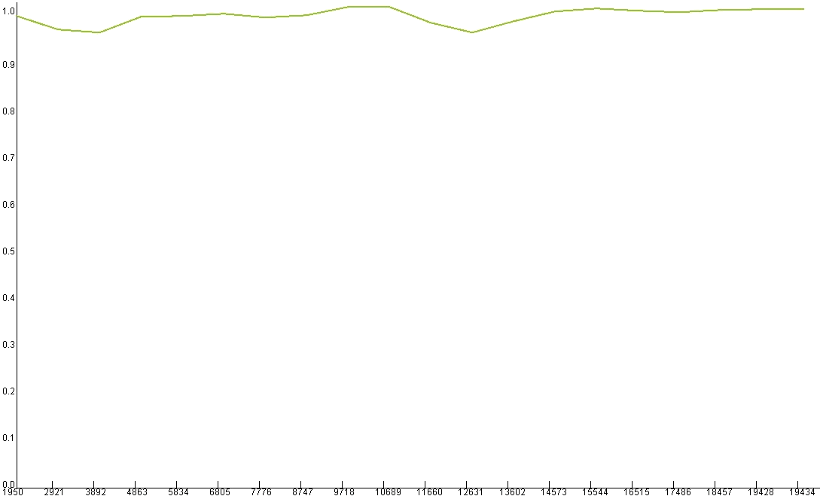
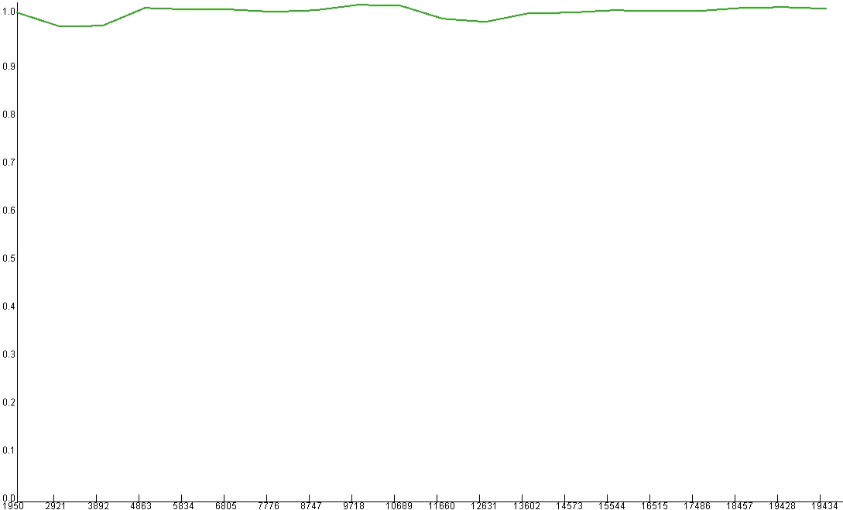
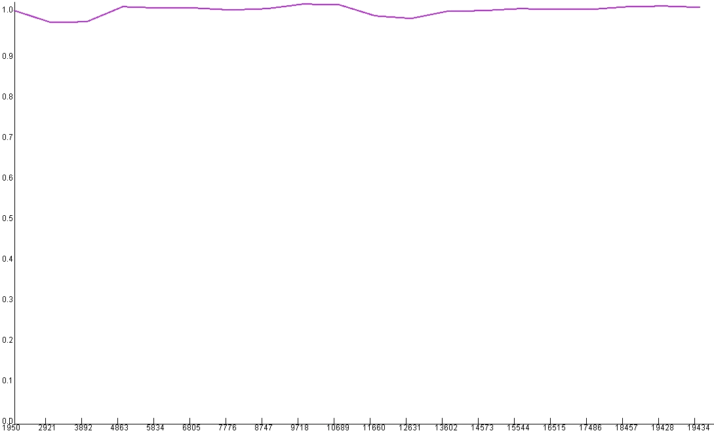
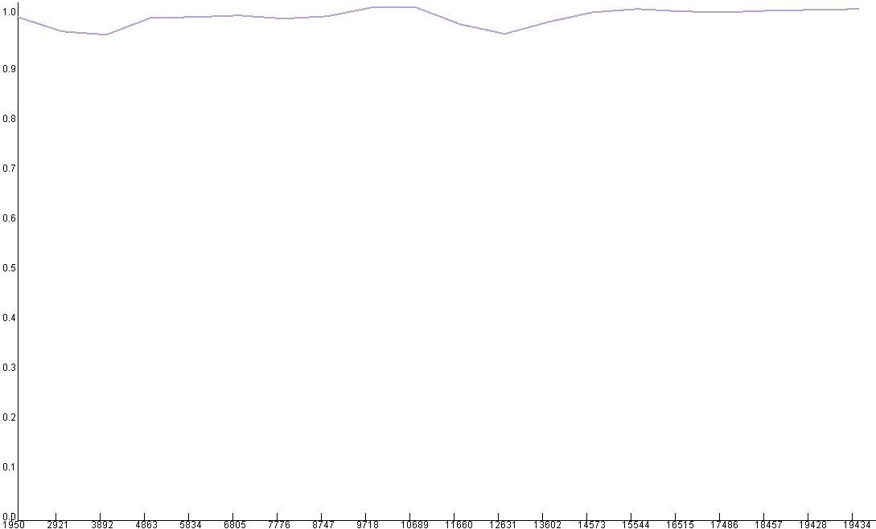
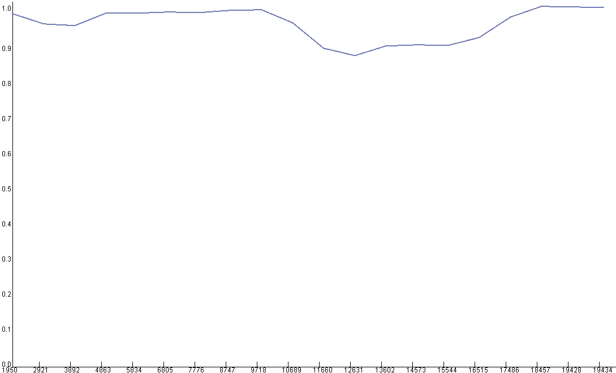
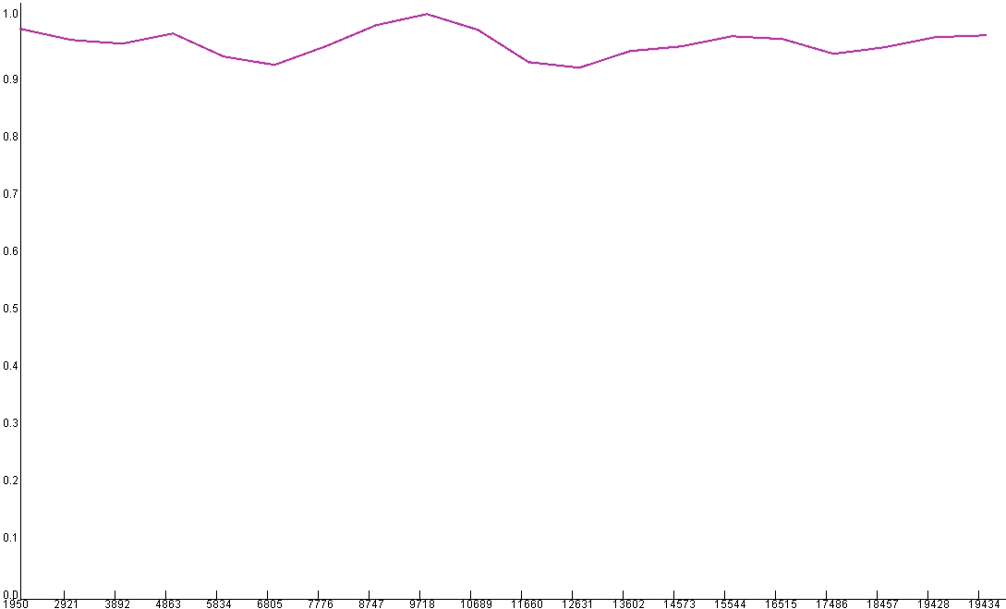
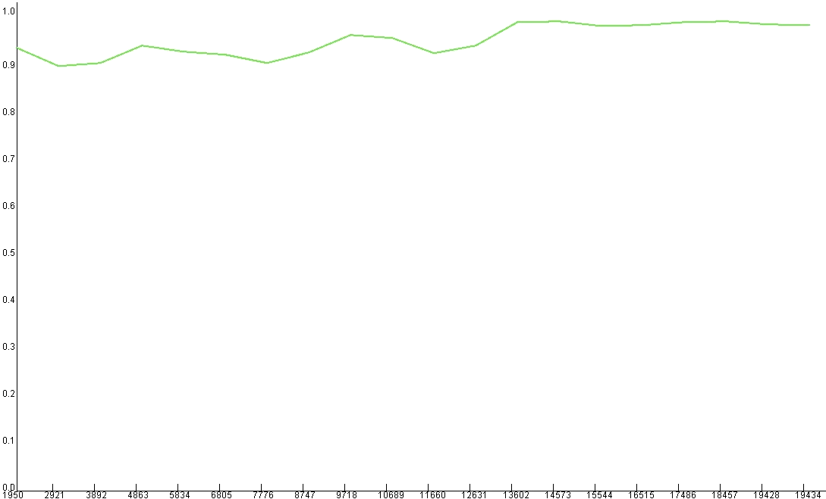
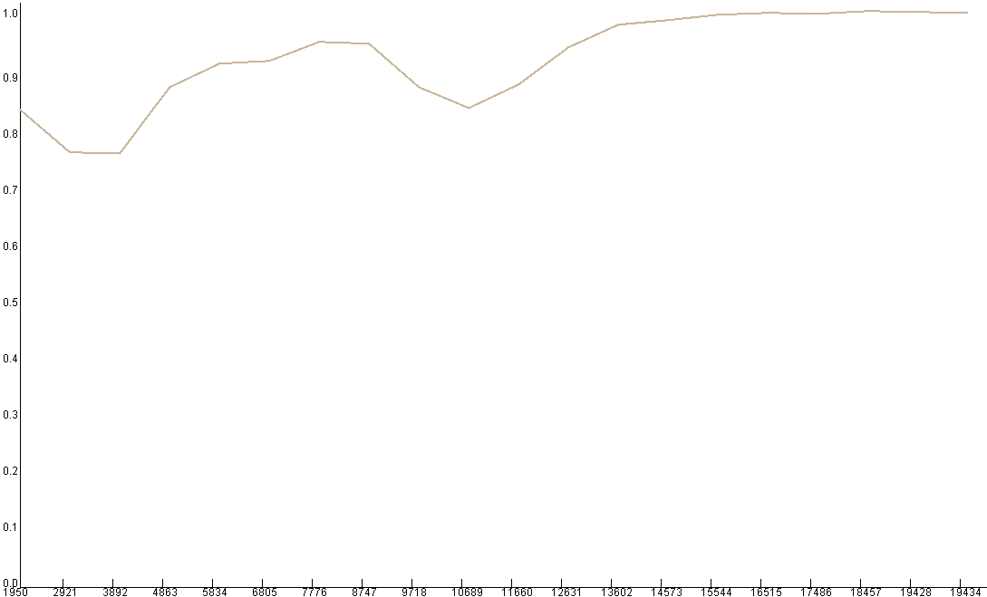
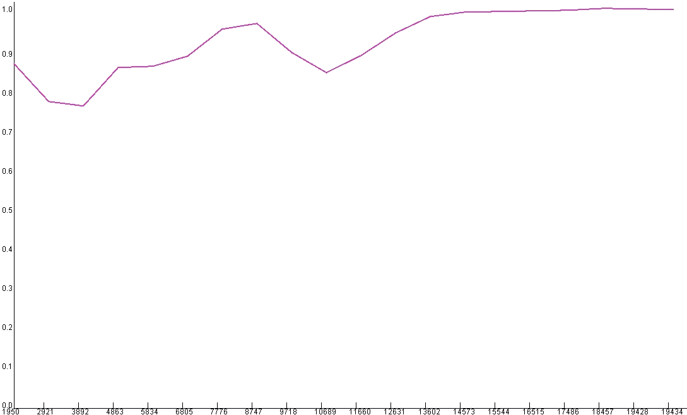
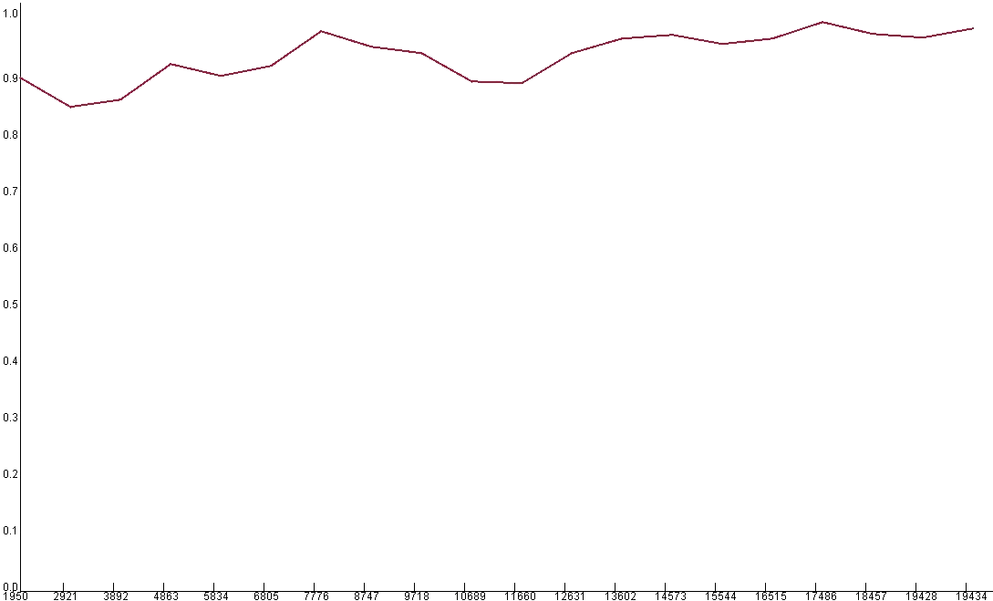
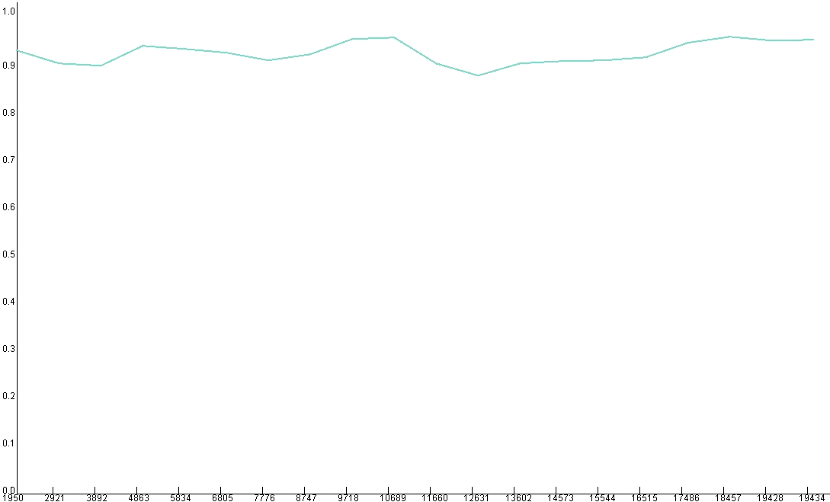
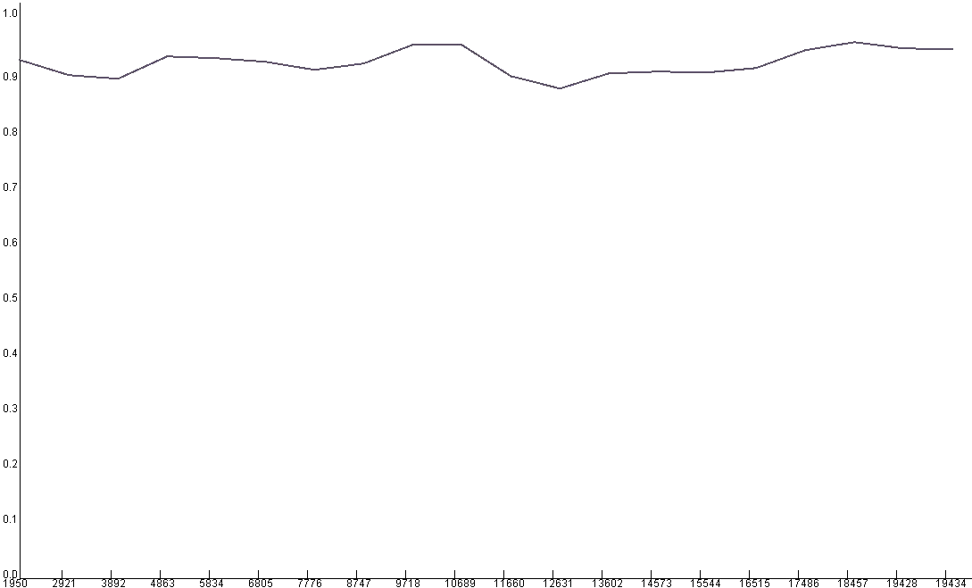
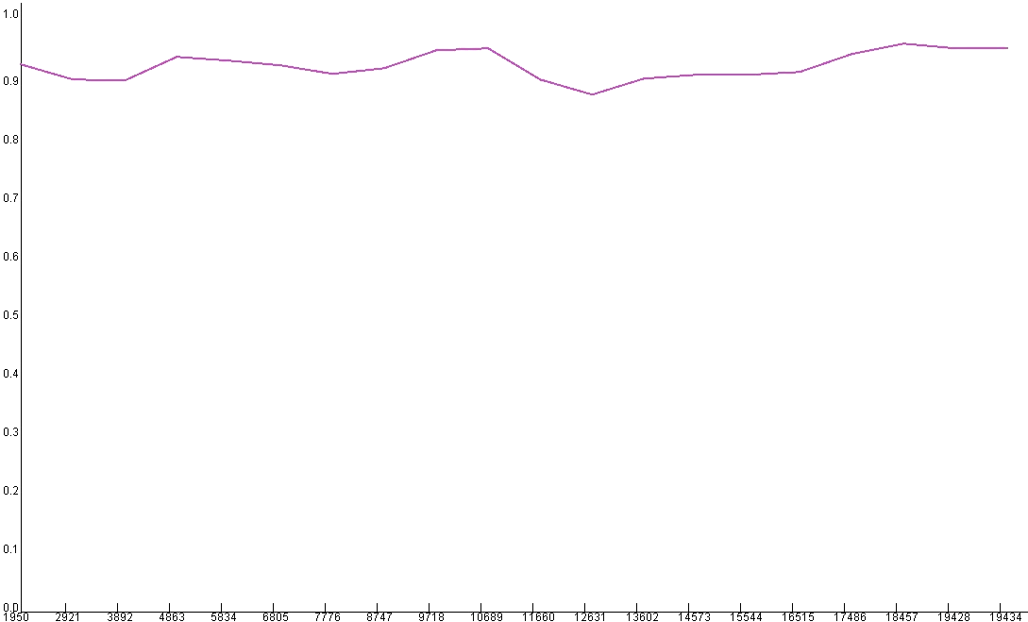
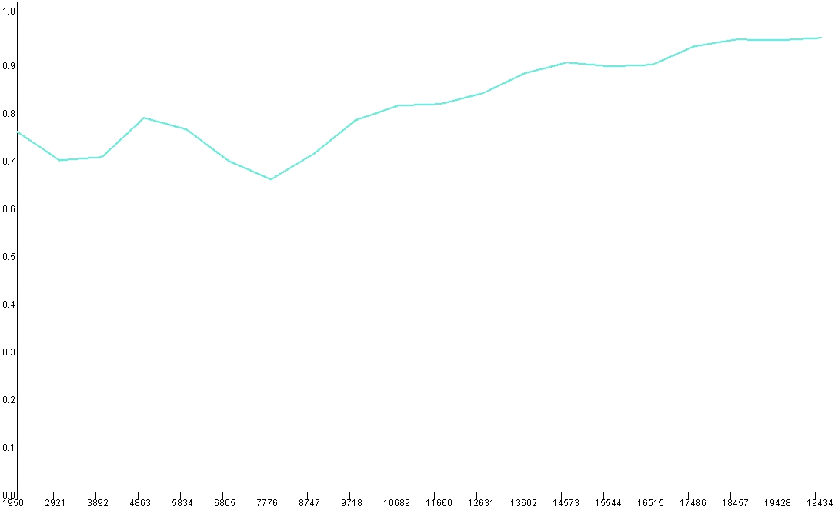
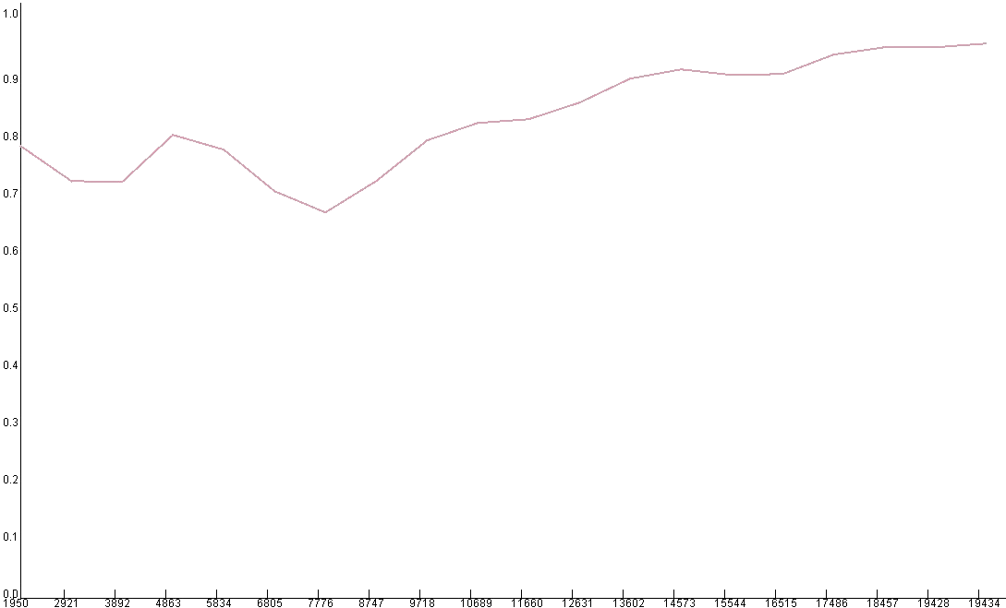
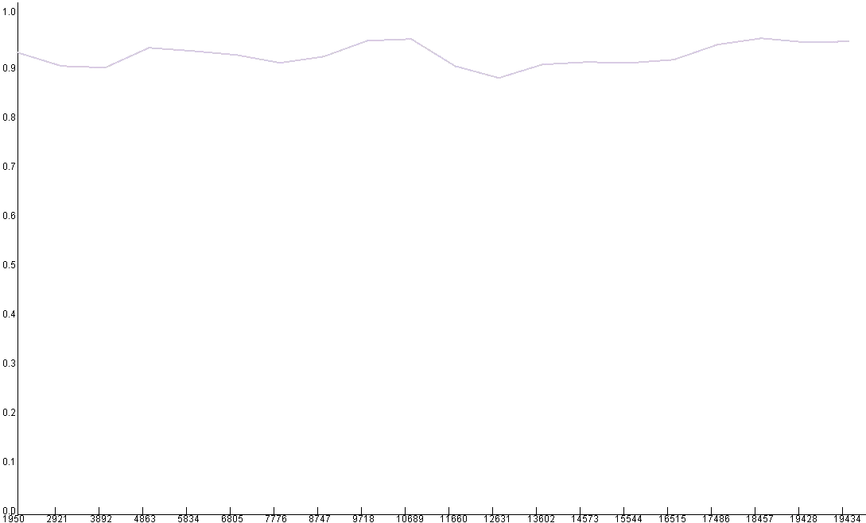
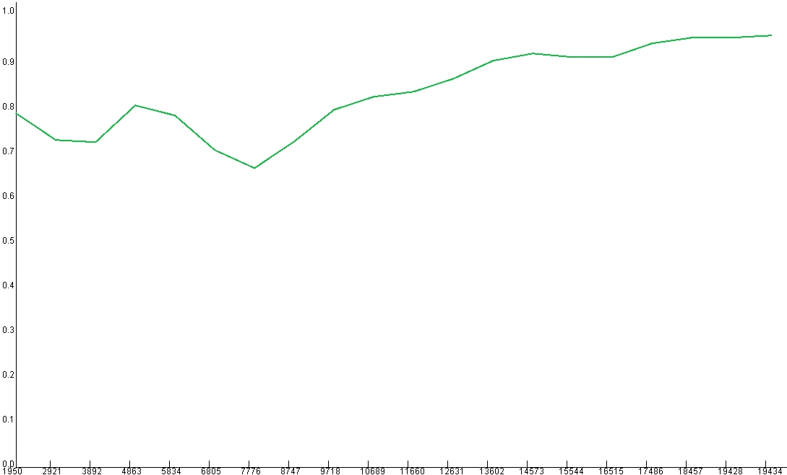
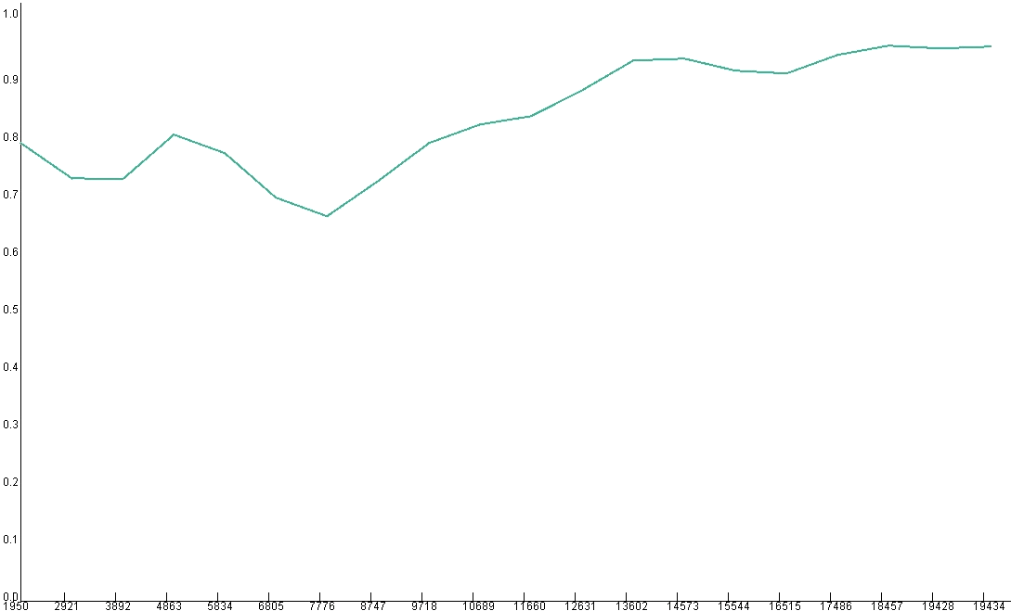
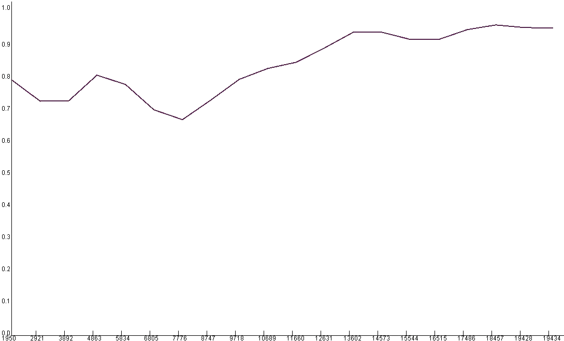
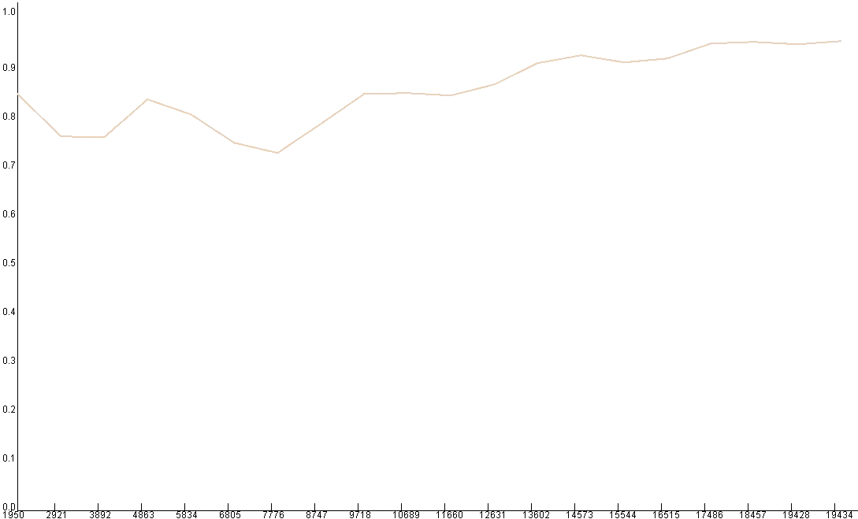
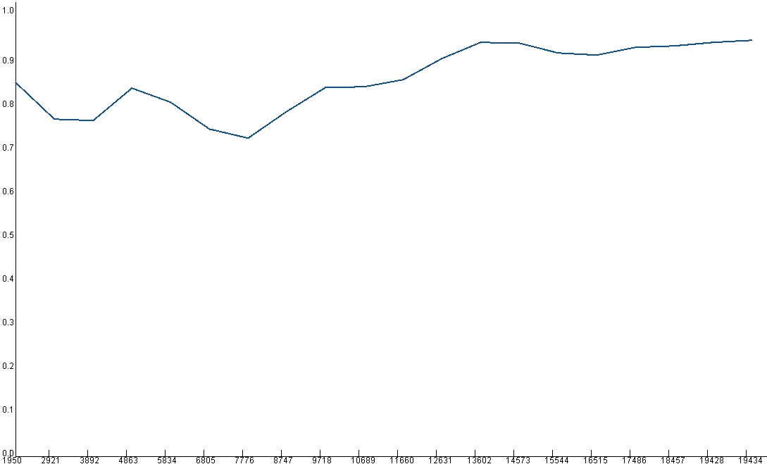
STRUTTURA GENETICA DELLA POPOLAZIONE DI Citrus tristeza virus
T318A
PSTS isolates
D
I
S
T
A
N
Z
A
G
E
N
E
T
I
C
A
1,0
MAC39
ALL isolates
MAC101
CT11A
Clear
SG29
KPG3
T318A
SY568
CT11A
SG29
VT
GENOTYPE
NZ-M16
T385
MAC39
MAC0
T30
MAC101
BAU282
A18
0,9
NZ-B18
NZRB-G90
MAC0
T30
T385
T30
GENOTYPE
B165
HA16-5
BAU282
PUM/M/T5
T36FS2-2
QAHA
T36
GENOTYPE
0,8
B301
MAC25
B301
RESISTANCE BREAKDOWN
GENOTYPE
QAHA
NZRB-G90
B165
B165
GENOTYPE
MAC25
NZ-B18
T36FS2-2
T3
GENOTYPE
NZ-M16
0,7
SY568
RDRP
P6
P61
P25
P13
P23
A18
ORF1A
P33
P65
P27
P18
P20
KPG3
RECOMBINANT
GENOTYPE
0 4858 9716 14574 19432
PUM/M/T5
SEQUENZA NUCLEOTIDICA (NT)
HA16-5

